Slide 1
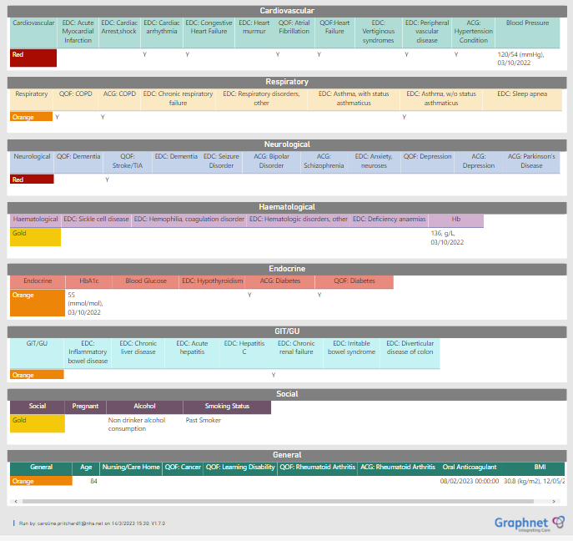
Digital Innovation in the Surgical Pathway: Building a Digital Pre-Operative Triage and Risk Assessment tool using a Population Health Platform
1. Armstrong, L ^{(i)} 2. Godfrey, L ^{(i)} 3. Stolworthy, K ^{(iii)} 4. Nicholson, I ^{(iv)} 5. Pritchard, C ^{(ii)} (i) Anaesthetic Trainee, Buckinghamshire Healthcare NHS Trust (ii) Anaesthetic Consultant, Buckinghamshire Healthcare NHS Trust
(iii) Transformation Director, Graphnet Health Ltd. (iv) Population Health Consultant, Graphnet Health Ltd.
Introduction
We present the use of a Digital Population Health Platform to automate risk stratification and triage of patients awaiting pre-operative assessment (POA). Our at-a-glance ‘surgical dashboard’ (Fig.1) has integrated the operational data on the surgical waiting lists (The PTL) , with the patient-level Integrated Care Record. The live dashboard allows visibility of available Primary Care data, on all our patients awaiting surgery. The aim was to further develop the dashboard to allow groups of patients to be identified and triaged according to their comorbidities. For surgical patients on the admitted pathways this enables high and low-risk patients waiting for surgery, to be instantly identified. We present the results of pre-implementation dashboard testing to assess functionality and safety.
Methods
Medical comorbidities were categorised into colour coded triage categories which were previously agreed prior to deployment of our electronic POA program. (Table 1). These rules are used by POA nurses to streamline patients into appropriate POA clinics . The coding rules were then applied digitally to all 38,000 patients on the PTL. During development, iterative testing of the dashboard coding was ongoing. Testing involved comparison between the dashboard allocated triage category and a manually defined triage using electronic medical records and the completed POA for each patient. Our final patient cohort of low risk ‘Gold’ patients was tested in the same way, and results presented below. Each patient was declared either true low-risk (ASA-1 equivalent) or a triage ‘failure’.
Fig 1. PTL Surgical Dashboard – an intuitive, user-friendly digital interface. Patients can be sorted according to demographics, surgical discipline, time spent on the waiting list and even searched by individual NHS number.
Fig 2. A right-click gives a visual breakdown of comorbidity and allows access to the Shared Care Record. Specific, detailed risk stratification is enabled through body system and disease-specific triage categories.
GOLD | ASA 1 equivalent (including BMI <35, age <65, non-smoking status, alcohol <14 units/week) | Suitable to proceed to surgery without POA appointment (HCA clinic only)
GREEN | ASA 2 equivalent (well controlled) | Suitable for nurse-led remote/telephone pre-op assessment
YELLOW | ASA 2 or 3 equivalent | Requires face-to-face pre-op assessment (may require formal anaesthetic review)
RED | ASA 4 equivalent | Requires face-to-face assessment and expected to require clinician review
Conclusion
Results of testing suggest our surgical dashboard is accurate at selecting and triaging patients according to their comorbidities, health status and other lifestyle factors such as smoking and BMI measurement. Triaging errors have been found to occur due to incomplete or inaccurate patient data held on the Integrated Care Record. Additionally, changes in a patients circumstances (e.g. BMI, new diagnoses) between the recording of data in primary care and POA triage may also lead to inappropriate risk stratification. We believe our PTL Surgical Dashboard Tool will be transformative in how elective surgical patients are managed at both a clinical and administrative level in Buckinghamshire Healthcare NHS Trust. We are already using the dashboard to prevent unnecessary POA appointments and investigations for our low risk patients. Using the dashboard, further collaborative work is ongoing with Primary Care and Public Health in Buckinghamshire, to identify patients awaiting surgery with medical conditions amenable to optimisation.
Table 1. Colour coded POA patient triage categories
Results
Of the final 100 patients sampled, the triage tool correctly identified 85% as truly ASA 1, labelled low-risk (Gold). Of the remaining 15 patients, triage failure occurred due to incomplete and inaccurate data on the integrated care record including BMI (6 patients) , alcohol intake (1 patient), difficulty coding OSA on the integrated care record (2 patients) , and patients with no data available on their record (4 patients). Conflicting diagnoses on the GP held record compared to secondary care records was noted in 4 cases.
Acknowledgements
The PTL Surgical Dashboard has been created and developed in collaboration with Graphnet Health Ltd.

